Slide 1
Open Source Platform and Network Administration
Lesson 24

Slide 3
Learning Objective
Establish a system baseline to detect anomalies.

Slide 4
Key Concepts
A secure baseline Linux system
Read-only versus live bootable operating systems
Local and remote log configuration
File and data integrity checkers

Slide 5
Importance of a Baseline
Helps you identify anomalies
Ensures computer system availability with regards to:
Increased network traffic
Hard drive usage
Potential hardware problems

Slide 6
Server Baseline
A default system configuration
Baseline system is secure
Helps in maintaining installed software
Performance of a baseline system can be monitored by using log files
Sources for ensuring the confidentiality, integrity, and availability of any server
Notes:
Tripwire
Stores a security policy containing rules for all files to be checked. When a file changes, Tripwire compares it against the checksum and fires an alert.
Advanced Intrusion Detection Environment (AIDE)
Developed as a replacement for Tripwire
Works within the same concept as Tripwire
Chkrootkit
Checks system binaries for modifications
Checks other files as well for rootkits and worms known to Linux
Rkhunter
Checks for rootkits and other vulnerabilities

Slide 7
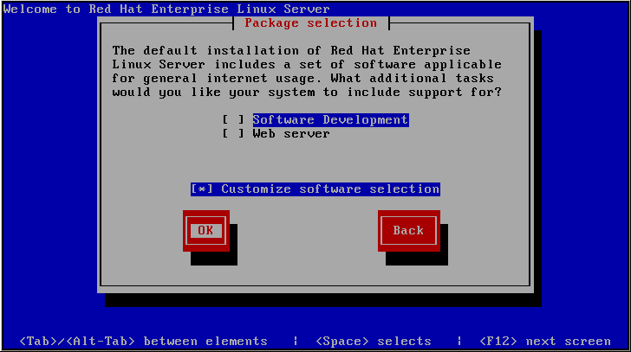
Customizing an RHEL 5 installation

Slide 8
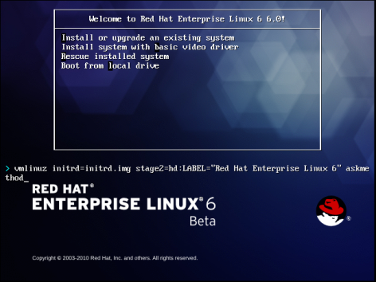
Starting an RHEL 6 Text-mode Installation

Slide 9
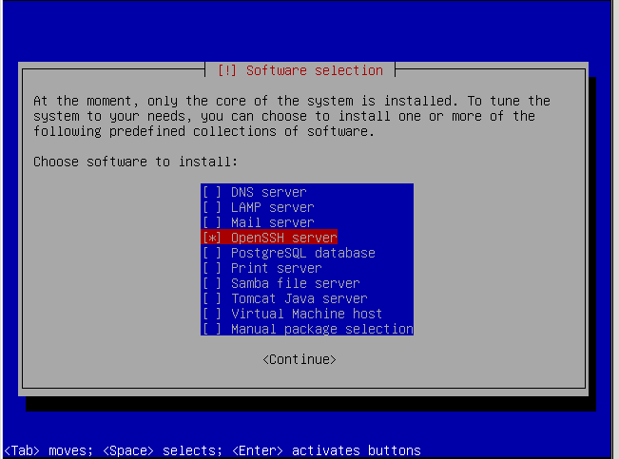
Ubuntu Software Selection Options

Slide 10
Read-only Mode Filesystem
Mounting a filesystem in read-only mode prevents a black-hat hacker from writing to the filesystem

Slide 11
Live Bootable Operating System
Linux live CD/DVD is a fully functional version of a Linux distribution
When booted, loads a fully functional version of Linux into RAM
Is independent of local hard-drive media
Useful for diagnosing problems with other connected physical media

